Slide 1
XGBoost
By
(Group 6):
Dharan Kumar Kunati
Nikhila Narla
Venkata Brahmini Ramasani
Venkata Sai Chandrika Gudipati

Slide 2
What is Boosting?
Boosting is a sequential technique which works on the principle of an ensemble. It combines a set of weak learners and delivers improved prediction accuracy, such as wisdom of crowds.

Slide 3
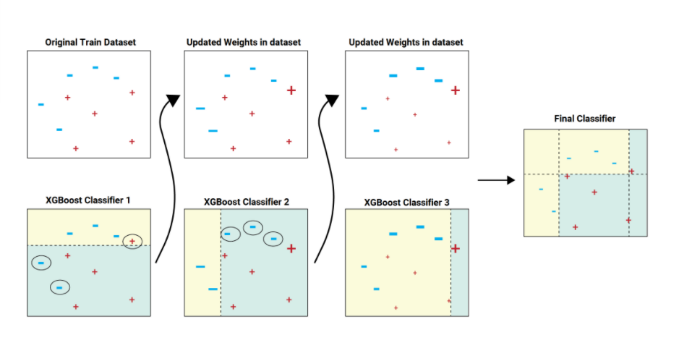
Understanding XGboost

Slide 4
Why XGBoost is popular
Speed and performance
Originally written in C++,relatively faster than other ensemble classifiers.
Core algorithm is parallelizable
Can harness the power of multi core computing
Consistently outperforms other models
Shown better performance on variety of machine learning benchmark datasets
Wide variety of tuning parameters
Parameters for cross-validation, regularisation,missing values.

Slide 5
XGBoost’s Hyperparameters
Learning rate: Step size shrinkage used to prevent overfitting
Max_depth:determines how deeply each tree is allowed to grow during any boosting round
n_Estimators : number of trees you want to use
Alpha: regularisation parameter,penalise models as the become more complex.

Slide 6
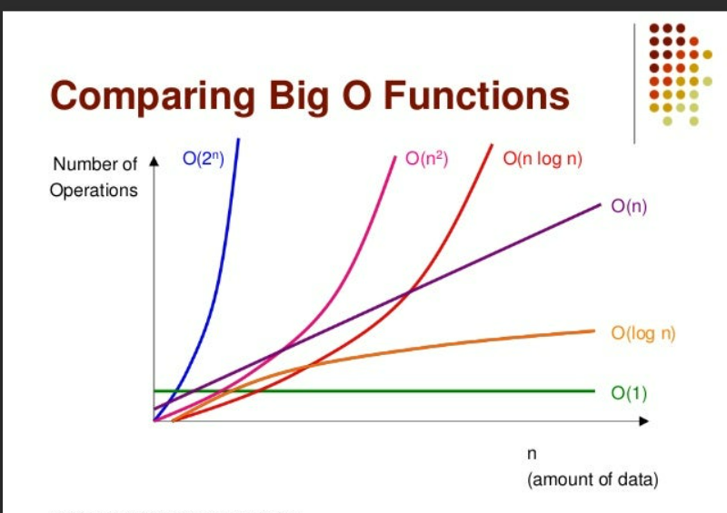
Time Complexity
O(n*k*d*logn) where n is the length of the input.
K - number of trees
D - max depth of a tree.

Slide 7
Cons
XGBoost is not good at extrapolation. Infact all tree models are not good at extrapolation.
If the training dataset only contains target values between 0 and 100, a tree-based regression model will have a hard time predicting a value outside of this range.
For any machine learning algorithms involving extrapolation, Neural networks will generally outperforms tree based models.

Slide 8
“When in doubt, use XGBoost” — Owen Zhang, Winner of Avito Context Ad Click Prediction competition on Kaggle

Slide 9
Questions

